Slide 1
Unveiling the Secrets of Google Play Store: An EDA Case Study
Chirag Patil - 201060005
Atharva Bendre -201060064
Yash Deshpande - 201060013
Shreyas Bhatlawande -201060062

Slide 2
INTRODUCTION
In today’s scenario we can see that mobile apps playing an important role in any individual’s life. With enormous challenge from everywhere throughout the globe, it is important for a designer to realize that he/she is continuing in the right way or not.
A few thousands of new applications are regularly uploaded on Google play store. A huge number of designers working freely on designing the apps and making them successful. With the enormous challenge from everywhere throughout the globe, it is important for a developer to know whether he/she is continuing the correct way or not. Since most Play Store applications are free, the income model is very obscure and inaccessible regarding how the in-application buys, in-application adverts and memberships add to the achievement of an application.
In this way, an application's prosperity is normally dictated by the quantity of installation of the application and the client appraisals that it has gotten over its lifetime instead of the income is created.

Slide 3
The contents of Play Store Data are:
App: It contains the name of the app with a short description (optional).
Category: This section gives the category to which an app belongs. In this dataset, the apps are divided among 33 categories.
Size: The disk space required to install the respective app.
Rating: The average rating given by the users for the respective app. It can be in between 1 and 5.
Reviews: The number of users that have dropped a review for the respective app.
Installs: The approximate number of times the respective app was installed.
Type: It states whether an app is free to use or paid.
Price: It gives the price payable to install the app. For free type apps, the price is zero.
Content rating: It states which age group is suitable to consume the content of the respective app.
Genres: It gives the genre(s) to which the respective app belongs.
Last updated: It gives the day in which the latest update for the respective app was released.
Current Ver: It gives the current version of the respective app.
Android Ver: It gives the android version of the respective app.

Slide 4
Problem Statement
The objective of this experiment is to deliver insights to understand customer demands better and thus help developers to popularize the product.
In this project we examine the different attributes present in the data set that affect the popularity of the application. We focused on to answer the questions like,
Which category has the most number of installations?
How many free apps does the Play Store have?
Which is the most common category of apps on Play Store?
Which is the most expensive category?
Which category has the highest number of reviews on Play Store?

Slide 5
What is Exploratory Data Analysis
Exploratory data analysis (EDA) is used by data scientists to analyze and investigate data sets for patterns, and anomalies (outliers), and form hypotheses based on our understanding of the dataset and summarize their main characteristics, often employing data visualization methods. It is an important step in any Data Analysis or Data Science project. It helps determine how best to manipulate data sources to get the answers you need.
EDA involves generating summary statistics for numerical data in the dataset and creating various graphical representations to understand the data better and make it more attractive and appealing.

Slide 6
Types of EDA
1.Univariate Analysis - It is the simplest form of analyzing the data. In this we would initially pick up a single attribute and study it in and out. It doesn't deal with any sort of correlation and its major purpose is to describe. It takes data, summarizes that data and finds patterns in the data.
2.Bivariate Analysis - This analysis is related to cause and the relationship between the two attributes. We will try to understand the dependency of attributes on each other.
3.Multivariate Analysis - This is done when more than two variables have to be analyzed simultaneously.

Slide 7
The following are steps involved in EDA
1.Problem Statement - We shall brainstorm and understand the given data set. We shall study the attributes present in it and try to do a philosophical analysis about their meaning and importance for this problem.
2.Data Collection - Every business knows the importance of using data beneficially by properly analyzing it. However, this depends on collecting the required data from various sources through surveys, social media, and customer reviews, to name a few.
3.Data Cleaning - We shall clean the dataset and handle the missing data, outliers and categorical variables.
4.Identify correlated variables-Finding a correlation between variables helps to know how a particular variable is related to another.
5.Visualizing and Analyzing Results-Once the analysis is over, the findings are to be observed cautiously and carefully so that proper interpretation can be made. The trends in the spread of data and correlation between variables give good insights for making suitable changes in the data parameters.

Slide 8
Steps Involved
After loading the dataset, we can start the exploration but before that, we need to check and see that the dataset is ready for performing several exploration operations or not, so let’s first have a look at the structure and the manner in which the data is organized.
Data Cleaning
Our data set contains a large number of null values in the rating column, so we drop them. Some of the columns have a smaller number of null values, so we replace the null values in these columns with the mode value of that particular column. Our data set also contain the duplicate rows for a single application. We also drop the duplicate rows because the rows contain the identical data. Also drop the rows, which have rating greater than 5.

Slide 9
Checking how many Outliers are there and Removing them
Outlier is a data object that deviates significantly from the rest of the data objects and behaves in a different manner. They can be caused by measurement or execution errors. The analysis of outlier data is referred to as outlier analysis or outlier mining.

Slide 10
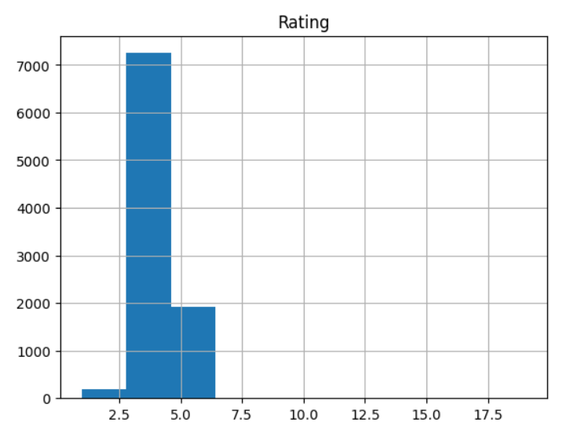
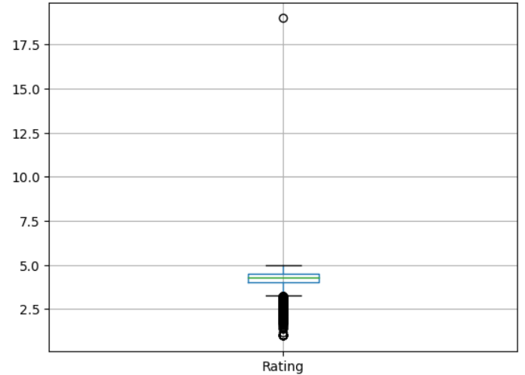
Box plot and Histogram when outliers present

Slide 11
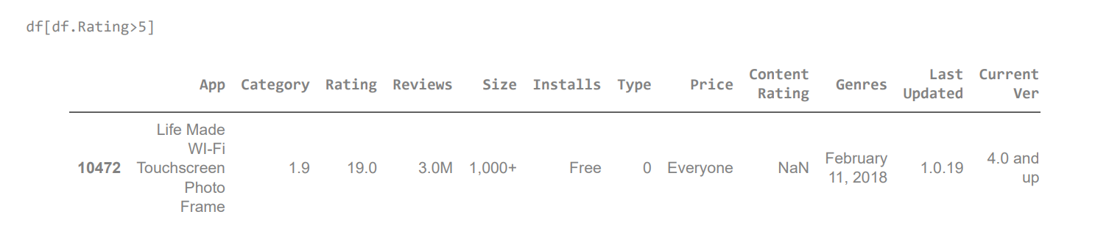
We find Point Outlier in our dataset by giving the condition of Ratings greater than 5

Slide 12
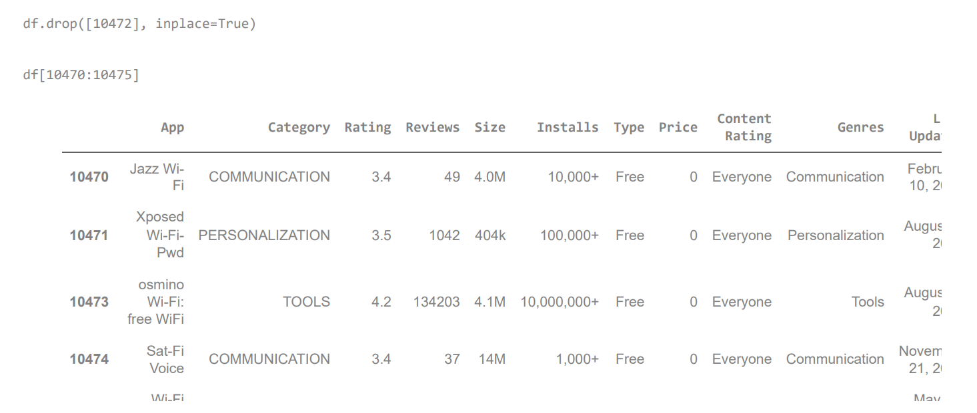
Removing Outlier

Slide 13
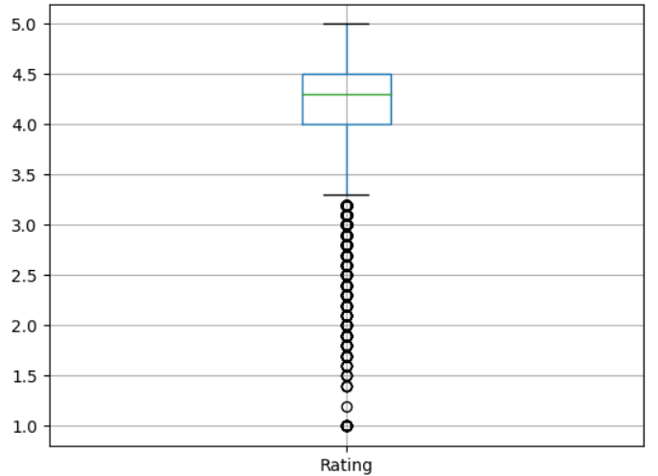
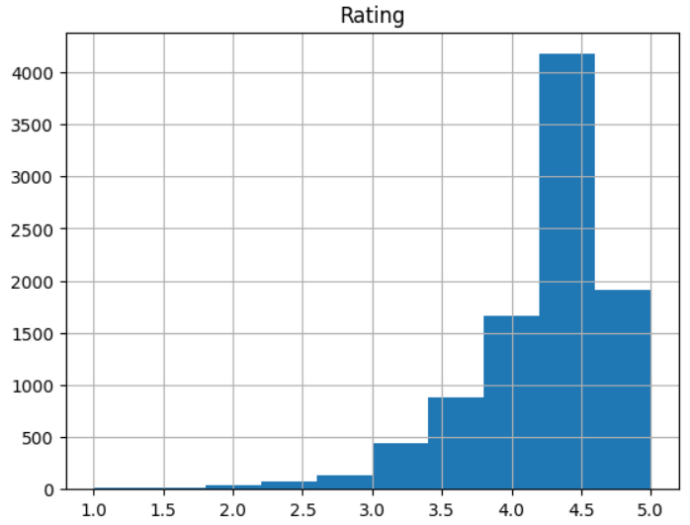
Box plot and Histogram when outliers removed

Slide 14
Data Visualization
In simple terms, Data Visualization is the process of generating graphical representations of data for various purposes. These graphical representations are commonly known as plots or charts in data science terminology.
There are many reasons for data visualization in data science. Data visualization benefits include communicating your results or findings, monitoring the model’s performance at the evaluation stage, hyperparameter tuning, identifying trends, patterns and correlation between dataset features, data cleaning such as outlier detection, and validating model assumptions.
In this case study we generate three graphical representations-
1.Category VS Install
2.Category VS Pricing
3.Category VS Reviews

Slide 15
Conclusion
Most of the apps are free so developers should focus on creating free apps to have a huge customer base. More Apps should be in the category like Events,Beauty,Parenting as they have not been explored much but still quite popular with huge installations. In order to retain the customer base apps should be updated regularly Developers should develop apps such that their content is available for everyone.
1. Most common category of apps on the Play Store is: Family
2. Percentage of free apps on the Play Store is: ~92%
3. Category with most number of app installs on the Play Store is: Communication
4. Category with the most number of reviews is: Communication
5. Category with the most expensive apps on the Play Store is: Finance

